Slide 1
Issue: Using Hospital Emergency Departments in Florida for Dental Problems Population: Underserved, Lower Socioeconomic Adults in Manatee County, Florida
Goal: To build and staff three hospital dental clinics inside Manatee County Hospitals to reduce health care costs and improve patient care.
1.1 Objective: Within six months secure funding for the dental clinics, build community partnerships and launch social media campaigns that focus on the new hospital dental clinics that are available for the underserved, lower socioeconomic adults in Manatee County, Florida.
1.2 Objective: By the end of the program, increase the proportion of adults in Manatee County, Florida who receive preventive interventions and oral health care education by 75%.
1.3 Objective: By the end of the program, improve access to dental care for underserved, low socioeconomic adults in Manatee County by 50%.
Goal: To reduce Emergency Department dependency for the underserved, lower socioeconomic adults with dental caries and the pain associated with dental emergencies in Manatee County, Florida.
1.1 Objective: By the end of the program, adults with non-traumatic dental-related problems managed in the ER will be decreased by 50% in Manatee County, Florida.
1.2 Objective: By the end of the program, adult dental patients with repeat visits to the ER in Manatee County, Florida will decrease by 75%.
1.3 Objective: By the end of the program, the barriers to accessing dental care to the underserved, lower socioeconomic adult population in Manatee County, Florida will be reduced by 35%.

Slide 2
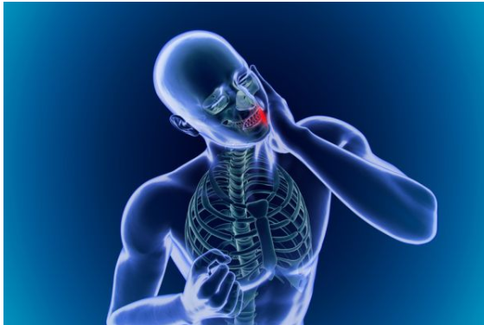
Acute pain and infection, lead individuals to seek care at one of the few facilities accessible to them:
the local hospital emergency department.

Slide 3
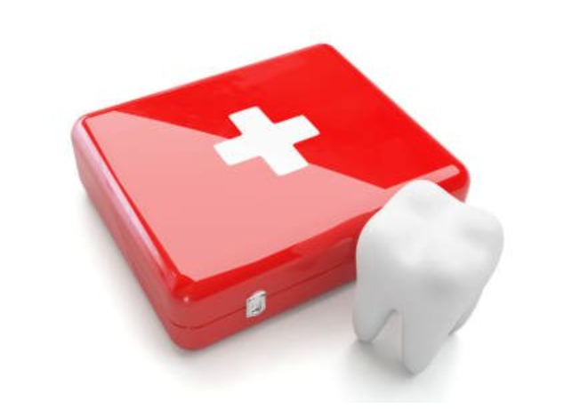
The utilization of Emergency Departments for dental conditions:
burdens the hospital
drains resources
becomes a cycle of care that does not treat and solve the underlying patient problem

Slide 4
A major driver of dental-related Emergency Department visits is a failure to ensure that disadvantaged people have access to routine preventive and restorative care.

Slide 5
Emergency departments are not equipped or staffed to provide definitive dental services, and most patients attending for a dental complaint receive only temporary palliative care.

Slide 6
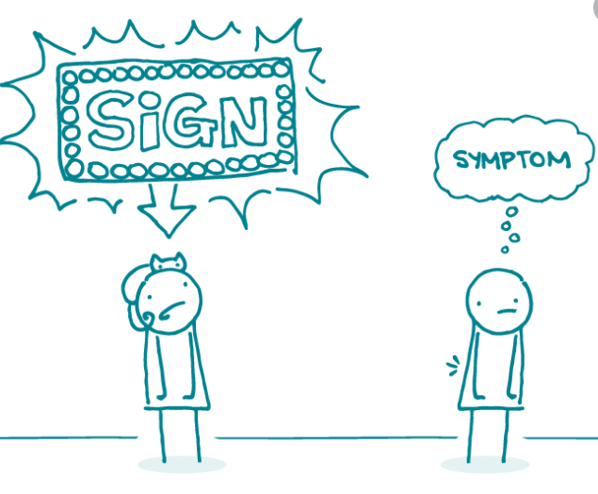
The reliance on emergency room dental treatment is symptomatic of a larger problem:
A public that is alarmingly uneducated about the severe consequences of inadequate dental care.
A system that refuses to acknowledge oral health as a crucial aspect of overall medical health.

Slide 7
Access to dental services is a challenge in Florida.
Barriers to care:
Affordability
Geographic location
Poor oral care literacy/language barrier
Low priority of dental public health
Lack of awareness of the need for care
Fear of dental procedures
Lower levels of education and income
Mal-distribution of dentists
Lack of dentist participation on Medicaid

Slide 8
Florida is one of the most ethnically and racially diverse states, with Hispanics/Latinos, African Americans, and Asians comprising of about 44% of Florida’s population (21.73 million, 2020).
An estimated 16.3% of Florida residents live below the federal poverty level.

Slide 9
Florida’s Medicaid program provides only emergency services.
Florida has one of the nation’s lowest Medicaid reimbursement rates.
The state’s Medicaid dental program has the nation’s lowest rate of dentist participation.

Slide 10
As of December 31, 2020, Florida had 259 dental care health professional shortage areas. This is by far the greatest projected shortfall of dentists among the states.

Slide 11
The number of dental-related visits to Florida Emergency Departments by persons aged 25-34 years comprised a larger proportion of visits than any other age group, accounting for about one-third (34.9%). About three-quarters of visits were by individuals covered by Medicaid (39.0%) or self-pay (35.6%).

Slide 12
Total charges for dental-related emergency department visits in Florida increased about four-fold from $47.7 million in 2005 to $234.4 million in 2014.

Slide 13
Manatee County Statistics

Slide 14
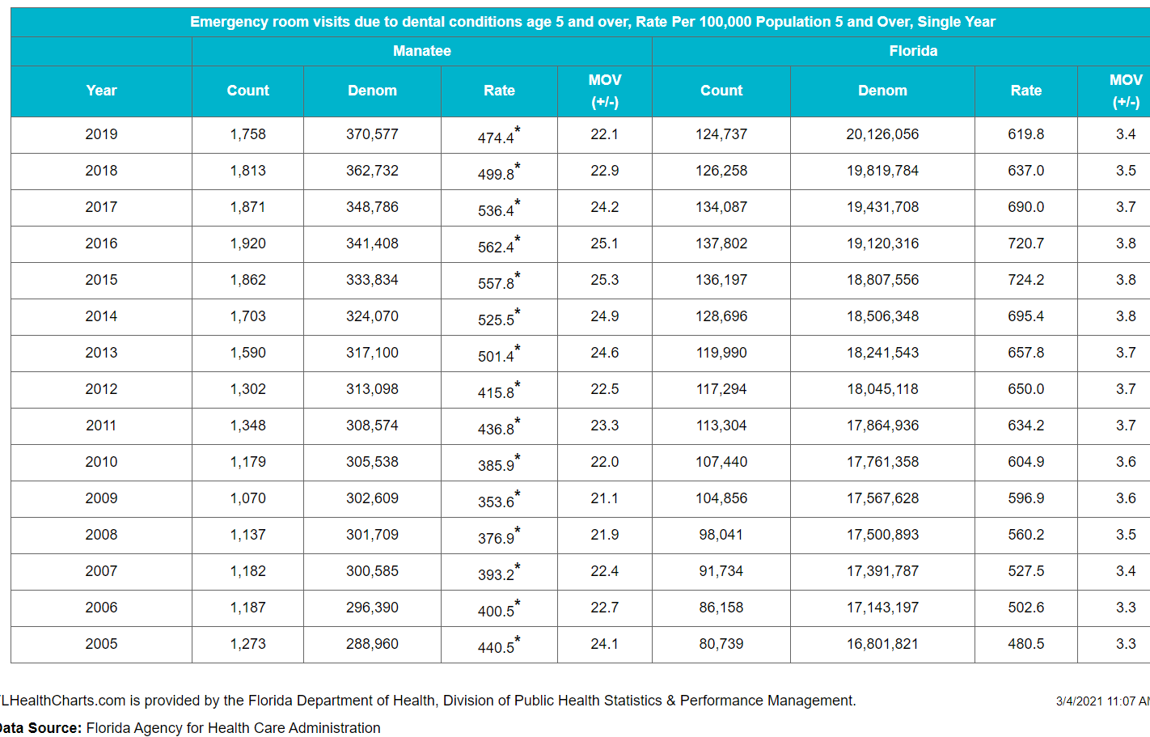
MOV - Measure of Variability: Probable range of values resulting from random fluctuations in the number of events. The MOV is useful for comparing rates to a goal or standard.

Slide 15
The only way that I can see a positive impact and a substantial reduction in ER visits for adults with oral pain is to bring a solution directly to the communities where we live.

Slide 16
Initiative: Get People the Right Care, in the Right Setting – Emergency Department to the Dental Chair

Slide 17
Plan: Build three Hospital Dental Clinics located inside of the Manatee County hospitals staffed with Employees and Volunteers. Patients must be a resident of Manatee County. No one will be turned away because of inability to pay.
Step 1: Identify the problem- Use of Hospital Emergency Departments in Manatee County, Florida for Dental Problems.
Step 2: Develop a one-page fact sheet about the program in English and Spanish to distribute to any parties that could potentially be involved in the program.
Step 3: Create a manual and course to be trained in communication skills, empathy, cultural awareness, professionalism, emotional intelligence, and mindfulness.

Slide 18
Oral Health Care Plan in Manatee County, Florida
Step 4: Identify who else cares about the issue- Create social media marketing campaigns on Linkedin, Facebook, Instagram, and Twitter with a call to action to see interest in volunteering for this program. One social media campaign will be developed to recruit bilingual healthcare professionals who wish to work in the dental clinics. Create a social marketing campaign for adults in Manatee County that have Medicaid or lack dental insurance coverage.
Step 5: Personally contact community funders, nonprofit organizations and local fraternal organizations to see what financial support they can provide including building the hospital dental clinics, providing funding for patients who can’t afford treatment, sponsorship and fundraisers. Reach out to dental manufacturers and dental dealers to see what they will donate to the clinics. Establish a meeting with the Department of Health regarding resources available and potential of establishing grants for hospital dental clinics.
Step 6:. Establish a meeting with (Health Catalyst) organizations that supports the expansion of all practice acts in dentistry to increase access to care.
Step 7: Contact local politicians/lobbyists, ER physicians and public health officials for assistance with passing the role of the Advanced Dental Therapist in Florida.

Slide 19
Oral Health Care Plan in Manatee County, Florida
Step 8: Contact LECOM and State College of Florida and meet with the administrators to establish relationships and sign contracts for the students to use these hospital dental clinics as their volunteer rotation sites.
Step 9: Contact hospital administrators at Manatee, Blake and Lakewood Ranch hospitals to have them send an email to all hospital staff members for participation in a virtual meeting to discuss the goals of the oral health program and the part that they can play in improving the oral health of the underserved population.
Step 10: Establish a partnership with the local public health department to develop a curriculum with the Community Dental Health Coordinators which will provide 30-minute dental health education lessons via social media.

Slide 20
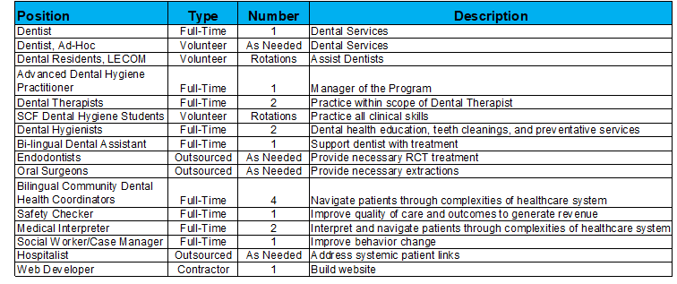
Oral Health Care Plan in Manatee County, Florida
Step 11: Invite everyone to a virtual meeting that are identified in Step 4-Step 10 that are interested in participating in the program to discuss details and expectations of the program.
Step 12: Establish a contract with Uber and Lyft with negotiated transportation rates for patients to and from hospital dental clinics.
Step 13: Employ a minimum of 50% being minorities for the following:

Slide 21
Oral Health Care Plan in Manatee County, Florida
Step 14: Establish a relationship with Endodontists and Oral Surgeons (Outsourced) in the community for referrals. The Community Dental Health Coordinators (CDHC) would be responsible to provide the endodontist and oral surgeon diagnostically acceptable radiographs for the patients that need treatment. This would be completed through Teledentistry.
Step 15: Schedule and train all staff members in a clinical setting focusing on their responsibilities.
Step 16: Create a community-level campaign to educate Medicaid enrollees about the hospital dental clinics in Manatee County.
Step 17: Create a community-level campaign that is focused on health promotion and health education with calls to action. If there are requests from the calls to action the CDHC will be responsible for responding to the requests. Track this information and run analytic reports.
Step 18: Design a tracking system for the hospital ER and the three dental clinics so that data can be utilized to show the progress and challenges of the program.

Slide 22
Oral Health Care Plan in Manatee County, Florida
Step 19: Hire a company to build a website for the Hospital Dental Clinics and include an area established for individuals and businesses to make donations and to register for volunteering on the website.
Step 20 : Implement the option for patients to send photos of their dental concerns over a secure network that is HIPPA compliant using teledentistry preceding an initial visit to the hospital dental clinic to increase care delivery to overcome unanticipated barriers and rapidly adapt to unforeseen situations. The dentist on staff and the Lecom dental residents will review the photos and make a decision.
Step 21: Open the hospital dental clinics and begin to see patients.
Step 22: After 30 days review the program and make any necessary changes that are needed.
Step 23: After 60 days see if there are reduced ER visits for non-emergency dental pain by reviewing the data analytics from the three hospital dental clinics tracking system.

Slide 23
Conclusion
Researchers found that uninsured young adults, ages 19-34, and low-income residents have the highest number of ER visits for dental pain and infections that aren’t related to trauma.
Preventative dental care is an investment against these costly emergencies and should be a simple solution.
Dental Clinics within the hospital could provide care to low-income patients who have nowhere else to turn.
With a bold oral health plan, we can all but eliminate routine dental problems clogging ERs by providing the right care in the right place: the dental chair.
The entire healthcare team should pitch in and turn this horrible situation around.

Slide 24
References
Bentley, C. (2018). Integrating Oral Health into Social Marketing Campaigns: Program Development and Description for San Francisco Children ’s Oral Health Strategic Plan. Pacific Journal of Health. 1(2). pp.1-18.
Dentistry Today (2020). Emergency room Visits for dental problems cost $2 billion a year.
Langelier, M., Rodat, C., & Moore, J. (2016). Case studies of 6 teledentistry programs: Strategies to increase access to general and specialty dental services. Oral Health Workforce Research Center, Center for Health Workforce Studies, School of Public Health, SUNY Albany.
Mayo, A. T., & Woolley, A. W. (2016). Teamwork in health care: Maximizing collective intelligence via inclusive collaboration and open communication. American Medical Association Journal of Ethics.
Minnesota Department of Health. (2016). Dental Therapy ToolKit: Literature Review. Office of Rural Health and Primary Care, Emerging Professions Program. pp. 1-27.
Public health institute (photo slide 16)
Sun, B. C., Chi, D. L., Schwarz, E., Milgrom, P., Yagapen, A., Malveau, S., Chen, Z., Chan, B., Danner, S., Owen, E., Morton, V., & Lowe, R. A. (2015). Emergency department visits for nontraumatic dental problems: a mixed-methods study. American journal of public health, 105(5), 947–955.
Tomar, S. L., Carden, D. L., Dodd, V. J., Catalanotto, F. A., & Herndon, J. B. (2016). Trends in dental-related use of hospital emergency departments in Florida. Journal of public health dentistry, 76(3), 249–257.

Slide 25
References
https://pdfslide.net/documents/analgesics-antibiotics-in-pediatric-dentistry.html (photo Slide 5)
https://www.drmarclazare.com/blog/low-cost-dental-care-options (photo Slide 4)
https://ercare24.com/can-emergency-rooms-provide-dental-care/ (photo Slide 3)
file:///BCD_HPSA_SCR50_Qtr_Smry.pdf (photo Slide 12)
https://journalofethics.ama-assn.org/article/language-based-inequity-health-care-who-poor-historian/2017-03
http://media.news.health.ufl.edu/misc/cod-oralhealth/docs/resources/data/er_data/MANATEE_FINAL_1.pdf (photo Slide 17)
https://xceed365.com/blog/2018/11/28/6-tips-on-setting-effective-goals-for-your-employees/ (photo Slide 1)
https://health.gov/healthypeople/objectives-and-data/browse-objectives/health-care/increase-use-oral-health-care-system-oh-08
https://www.apa.org/monitor/2019/12/ce-corner-race (photo Slide 10)
https://chambleedental.com/blog/how-to-alleviate-tooth-pain/ (photo Slide 2)
https://www.dentaldelaware.com/news/dentist-accepting-medicaid-georgetown/ (photo Slide 11)

